Slide 1

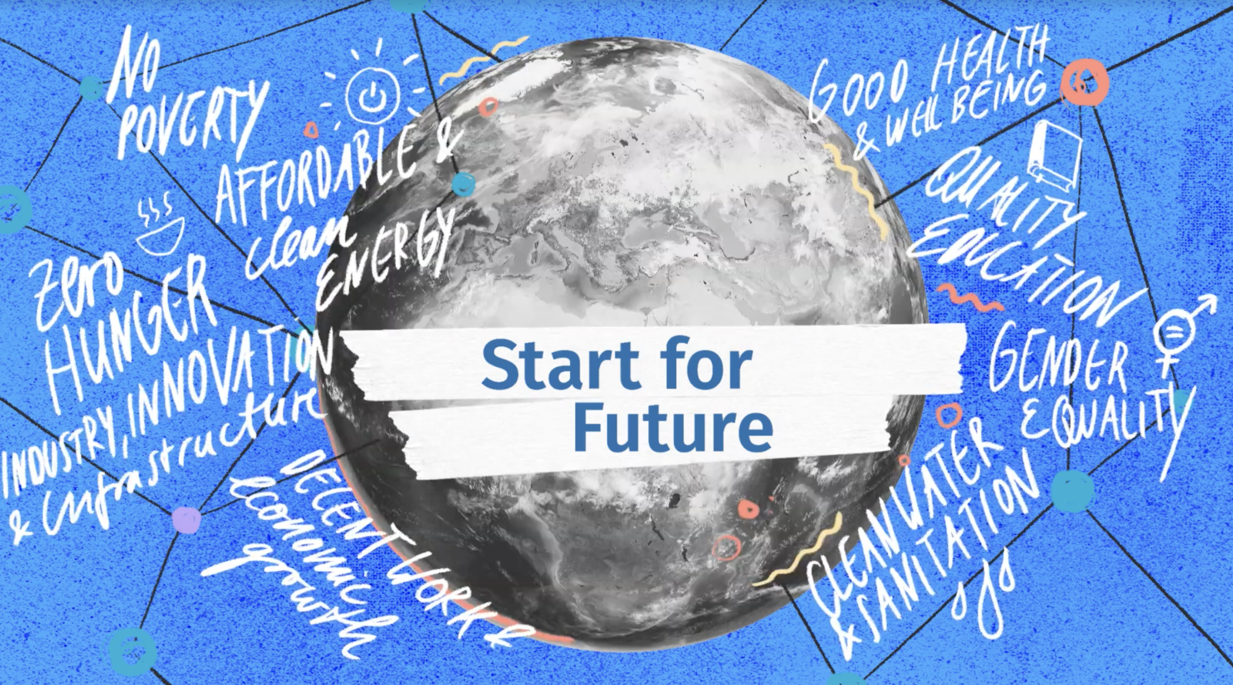
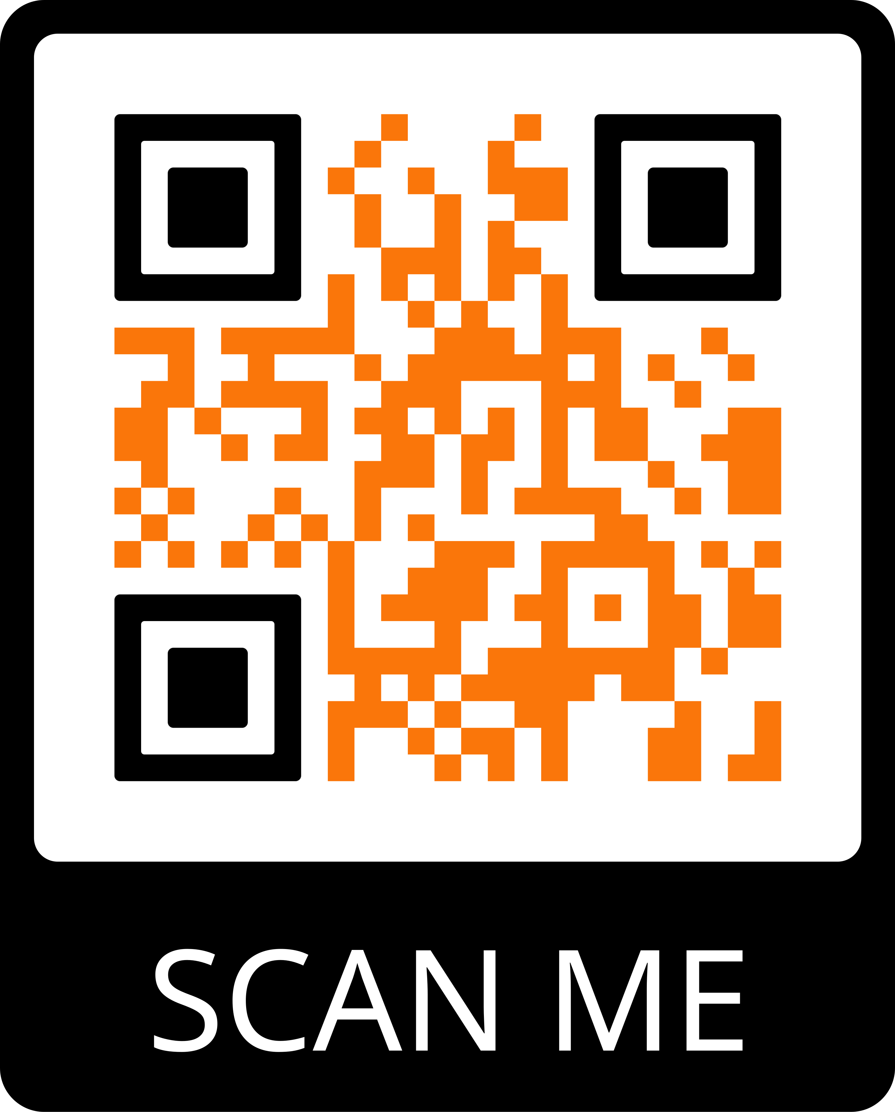
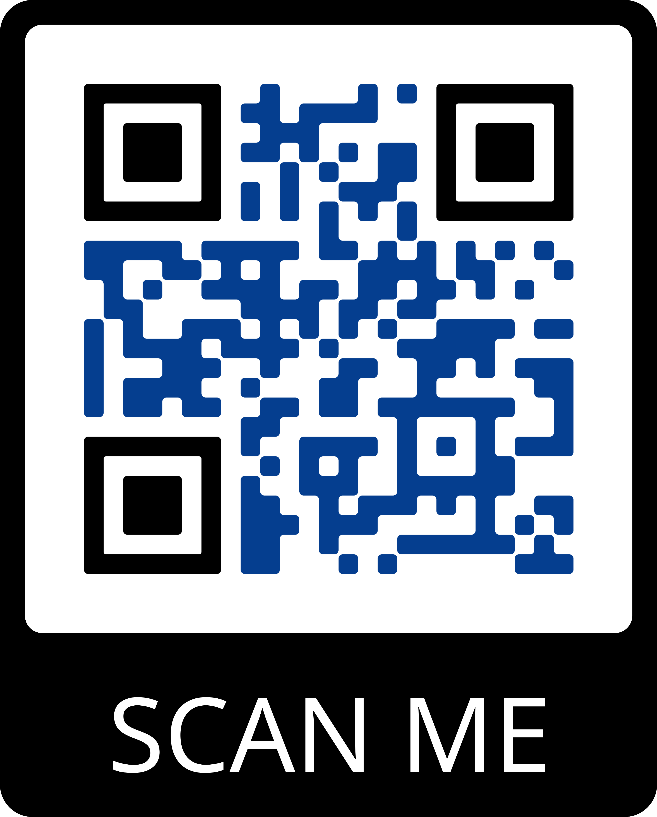

OPEN CALL UNTIL DECEMBER 19th,2021
Looking for
Entrepreneurial Students & Talents wishing to join an early-stage startup team
Early-stage & Student Startup teams looking to further develop their innovation
Innovations & Startup Ideas must be in line with the following topics:
  Manufacturing
  Circular Economy
  Sustainable Urban Mobility
What
8-week program starting on January 29th, 2022, where you will accelerate your startup idea, with the help of coaching from incubator consultants, industry and EIT experts (20+ International Partners)
Exchange with international talents and startup teams
Possibility for teams to find new members, and talents to find teams
Preparation to be pitch ready by March 25th, 2022
Possibility to join one of our 18 incubators at conclusion of the 8 weeks
20+ International Partners
Individual Student & Talent Application
Early-stage startups & Student Teams Application
INFO FLYER
VIDEO
Notes:
Open Call Flyer for more Information: https://cutt.ly/0TWY4fS
APPLICATION LINKS
Teams and startups: https://cutt.ly/ETn4owg
Individuals/Talents: https://cutt.ly/eTn4doX

